Slide 1
Logical Reasoning
Induction and Deduction

Slide 2

What Is Logical Reasoning?
Any attempt to come to a conclusion about the world, answer a question, or support a theory using intellect (not emotion, intuition, or personal connection)

Slide 3
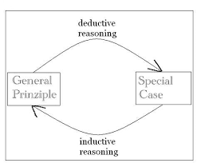
Induction versus Deduction

Slide 4
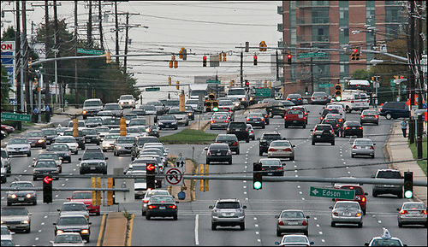
Case Study: Seatbelts on Rockville Pike
Question: How many drivers on Rockville Pike are wearing seatbelts on a regular basis?

Slide 5
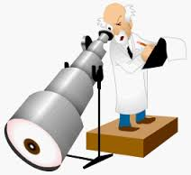
Inductive Approach
I go out to a corner on Rockville Pike and count the drivers wearing seatbelts for one hour.
I find that 567 of 602 drivers are wearing seatbelts.
Conclusion: The vast majority of drivers on Rockville Pike wear their seatbelts.

Slide 6
Potential Problems with Induction
Sample size could be too small
Sample is not random, is somehow skewed
Person conducting the study is not objective or honest
Conclusion makes too big of a leap (hasty generalization)

Slide 7

Deductive Approach
I begin with some general premises:
PREMISE 1: There is no reason that a mature, responsible adult driver would not wear his or her seatbelt.
PREMISE 2: Most drivers on Rockville Pike are mature, responsible adults.
THEREFORE: I conclude that most drivers on Rockville Pike wear their seatbelts.

Slide 8
Potential Problems with Deduction
Premises are not true
Logic is not valid

Slide 9
Proofs: Valid, True, Sound
VALID proofs have correct reasoning (but do not guarantee premises are accurate)
TRUE proofs begin with correct premises (but do not guarantee that logic is correct)
SOUND proofs = BOTH VALID AND TRUE

Slide 10

VALID Proof Example
All frogs are red.
Kermit is a frog.
∴Kermit is red.

Slide 11

TRUE Proof Example
In the fall semester, Montgomery College sometimes has closed due to inclement weather.
It is currently a fall semester.
∴ Montgomery College will close due to inclement weather.

Slide 12

SOUND Proof Example
All 102 students need to turn in all essays to pass the course.
Student X did not turn in all essays.
∴ Student X did not pass the course.

